Slide 1
IPL Analysis
Presented by – Devesh sahu

Slide 2
INTRODUCTION
The Indian Premier League (IPL) generates massive ball-by-ball data every season.
This project leverages SQL-based data analysis to extract actionable insights for Using structured queries, performance Royal Challengers Bangalore (RCB).
e metrics, and strategic KPIs, we transform raw match data into meaningful patterns that support:
Tactical decision-making
Player evaluation
Venue-based strategy planning
Season performance assessment
This project demonstrates how data analytics can influence sports strategy.

Slide 3
OBJECTIVE
Performance Evaluation:
Analyze batting and bowling efficiency
Calculate KPIs
Venue-Based Analysis:
Identify venue-specialist players
Compare performance across different stadiums
Measure dependency on home ground advantage
Home vs Away Comparison:
Evaluate differences in scoring patterns and wicket-taking ability
Assess adaptability in different playing conditions

Slide 4
Consistency & Player Impact:
Identify consistently performing players across seasons
Rank players based on impact metrics
Season-over-Season Growth:
Compare yearly runs and wickets
Measure improvement or decline in team performance
Strategic KPI Development:
Develop advanced metrics to support team strategy
Provide insights for tactical decision-making

Slide 5
PROBLEM STATEMENT
Royal Challengers Bangalore (RCB) is one of the most popular IPL teams but has shown inconsistent performance across seasons, venues, and match conditions despite having strong individual players.
This project aims to:
Identify performance patterns affecting match outcomes.
Analyze venue and match condition impact .
Evaluate player consistency and specialization.
Compare home vs away performance.
Track season-over-season trends

Slide 6
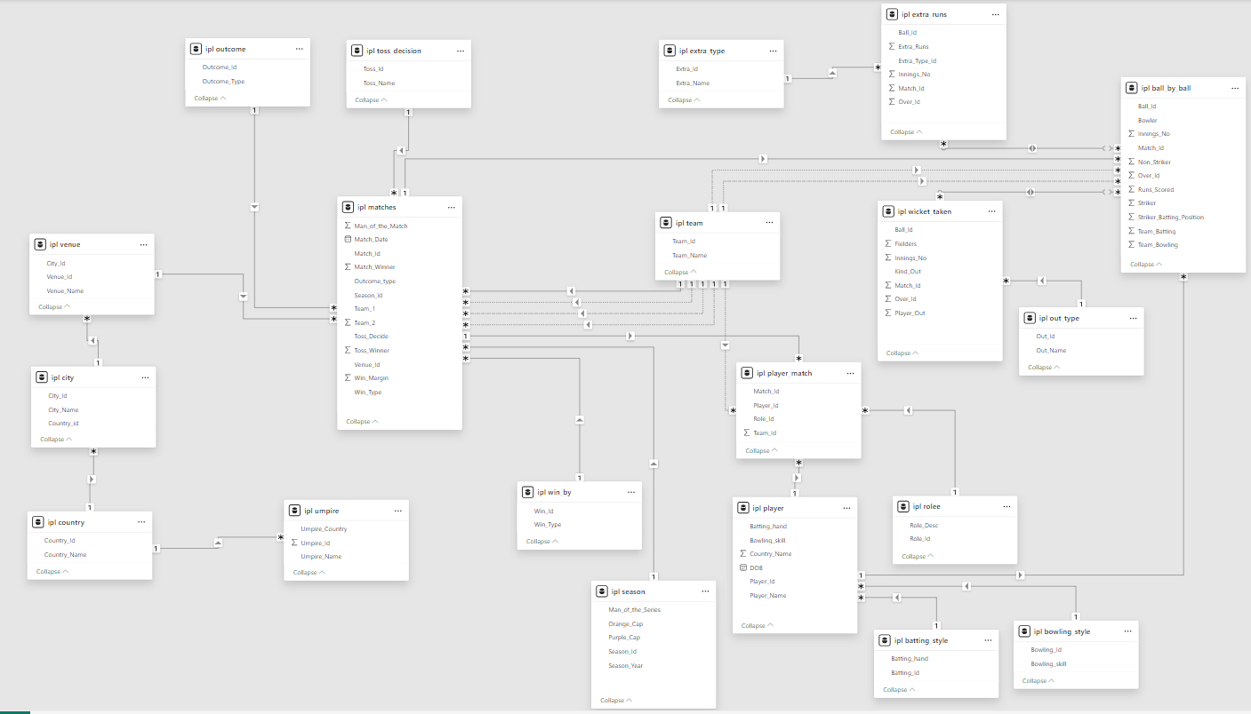
DATABASE SCHEMA

Slide 7
DATA DESCRIPTION
Matches
Match_Id: Unique identifier for each match.
Match_Date: The date when the match took place.
Match_Winner: The team that won the match.
Outcome_Type: Type of result (win, tie, etc.).
Toss_Winner: The team that won the toss.
Win_Type: The method by which the match was won (e.g., runs or wickets).
Win_Margin: The margin by which the match was won.
Venue_Id: Reference to the venue where the match was played.
Season_Id: The season in which the match occurred.
Venue
Venue_Id: Unique identifier for each venue.
Venue_Name: Name of the venue.
City_Id: Reference to the city where the venue is located.
Player
Player_Id: Unique identifier for a player.
Player_Name: The name of a player.

Slide 8
DATA DESCRIPTION
Player_Out: Reference to the player who was dismissed.
Season
Season_Id: Unique identifier for a particular season or tournament.
Venue_Id: Unique identifier for the venue or stadium where the match is played..
Player Match
Match_Id: Reference to the match in which the player participated.
Player_Id: Reference to the player.
Role_Id: Role of the player (e.g., batsman, bowler).
Team_Id: Team that the player represented in the match.
Wickets Taken
Ball_Id: Reference to the specific ball during which the wicket was taken.
Fielder: Reference to the player who fielded the ball.
Bowler: Reference to the bowler who took the wicket.

Slide 9
DATA DESCRIPTION
Ball by Ball
Match_id: Unique identifier for a cricket match
Over_id: Unique identifier for an over in a cricket match
Ball_id: Unique identifier for a ball in an over
Innings_No: The innings number in a cricket match
Team_Batting: The team batting in a particular innings
Team_Bowling: The team bowling in a particular innings
Striker_Batting_Position: The batting position of the striker batsman
Striker: The batsman currently on strike
Non_Striker: The batsman currently at the
Bowler: The bowler bowling the current delivery
Out_Type
Out_Id: Unique identifier for the type of dismissal or way a batsman got out.
Out_Name: The name or description of the type of dismissal (e.g., caught, bowled, lbw, run out).
Outcome_Id: Unique identifier for the outcome or result of a match.

Slide 10
DATA DESCRIPTION
Extra Runs
Ball_Id: Reference to the specific ball during which extra runs were conceded.
Extra_Type_Id: Type of extra run (e.g., wide, no-ball).
Innings_No: The innings number during which the extra run occurred.
Match_Id: Reference to the match in which the extra runs were conceded.
Team
Team_Id: Unique identifier for a team.
Team_Name: The name of a team.
Extra Type
Extra_Type_Id: Unique identifier for the type of extra runs scored in a cricket match.
Extra_Runs: The number of extra runs scored in a particular delivery.
Innings_No: The innings number in a cricket match.
Extra_Id: Unique identifier for an instance of extra runs scored.
Extra_Name: The name or description of the type of extra runs scored (e.g., byes, leg byes, wides, no-balls).

Slide 11
METHODOLOGY
Analytical Framework:
A structured SQL-based approach was used to convert raw IPL data into strategic insights for RCB.
Data Understanding:
Analyzed database schema and relationships
Identified key tables
Data Preparation:
Joined tables using match_id and player_id
Filtered RCB-specific data
KPI Development:
Batting: Total Runs, Average, Strike Rate, Boundary %
Bowling: Wickets per Match, Dot Ball %

Slide 12
METHODOLOGY
Advanced SQL Techniques Used:
Common Table Expressions (CTEs) for modular queries
Aggregate functions (SUM, AVG, COUNT)
Window functions for ranking
Comparative Analysis
Home vs Away performance
Venue specialization detection
Season-over-season performance trends
Visualization & Insight Extraction
Generated structured outputs
Created pivot tables and performance charts

Slide 13
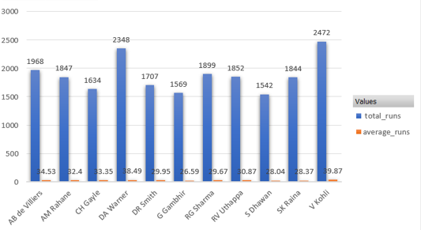
ANALYSIS OF OBJECTIVE QUESTIONS
TOP BATSMAN:
The visual shows the top 10 RCB performers across seasons.
RCB should focus on retaining these core players.

Slide 14
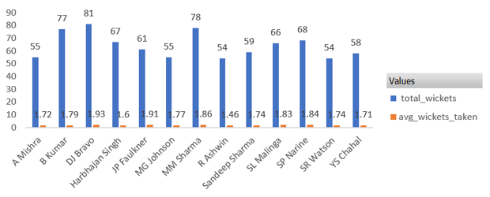
Bowling performance:
RCB’s bowling has mainly depended on overseas players like Starc, Watson, and Wiese.
This shows a lack of strong and reliable domestic bowling options.
RCB should invest in talented Indian bowlers who can use home conditions effectively.

Slide 15
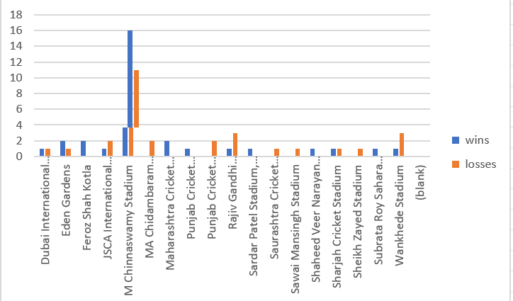
RCB’s performance across different venues:
As we can see that RCB performes better at its home ground.
And there are mix scenario in different ground.

Slide 16
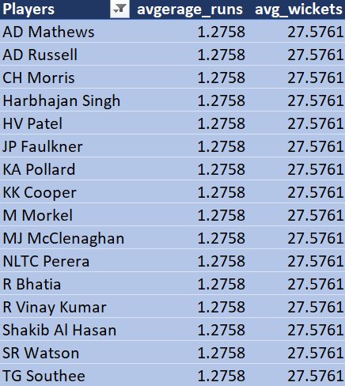
Recommended All rounders for mega Auction:
These all-rounders have shown consistent batting and bowling performances.
Players like CH Morris, RA Jadeja, and JP Faulkner can add great balance.
RCB lacks strong all-rounders, affecting both batting depth and bowling options.
Focus on signing 1–2 impactful all-rounders to strengthen team balance

Slide 17
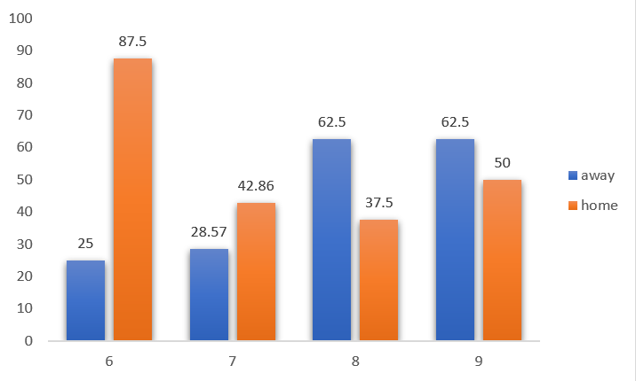
home vs away performance:
Season 6, 7 and 9 has the best win performance at home ground.
Season 8 has very low performance comparatively.

Slide 18
Strategic Recommendations:
Optimize Venue-Based Selection:
Use venue-specialist players based on past performance
Adjust playing XI according to stadium conditions
Strengthen Away Performance:
Improve adaptability in away matches
Modify team combinations based on performance gaps
Improve Death-Over Bowling:
Focus on bowlers with better economy and control
Reduce run leakage and increase dot ball percentage

Slide 19
Strategic Recommendations:
Retain and Prioritize Consistent Performers:
Identify players with stable season-over-season averages
Reduce over-dependence on single high-impact players
Build balanced team structure
Data-Driven Match Preparation:
Use opponent and venue-specific historical trends
Prepare tactical plans based on past performance data
Incorporate analytical insights into team selection meetings

Slide 20
CONCLUSION
Successfully transformed raw IPL ball-by-ball data into structured strategic
Insights using SQL.
Evaluated key performance areas including batting efficiency, bowling effectiveness,
venue impact, and seasonal trends.
Identified measurable patterns that influence match outcomes and team consistency.
Demonstrated how data-driven KPIs can support player selection and match
planning.
Established that structured data analytics can provide a competitive advantage in
sports strategy.

Slide 21


